Slide 1
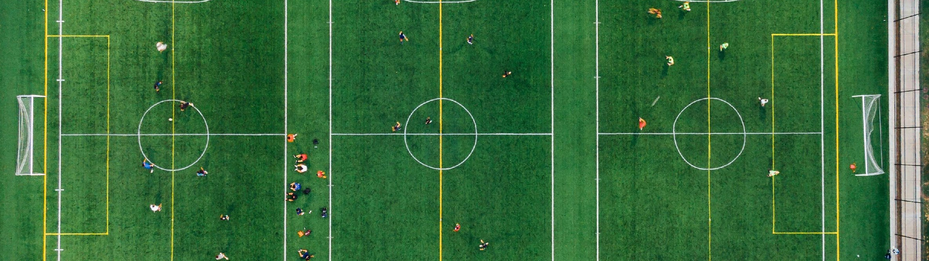


2025 AGM
Huntsville Soccer Club
Annual General Meeting
November 19th, 2025
7:00pm

Slide 2
Welcome
Welcome to the Huntsville Soccer Club’s Virtual Annual General Meeting!
Notes:
Call to order.
Minutes being taken by Club Secretary.
Notice was provided in accordance with our Bylaws. We had to adjourn to allow for financials to be completed but we are ready to go.
Roll Call (including proxies).
Confirm that quorum (which is 8 members) has been met.
We therefore have a validly constituted meeting and can proceed with tonight’s business.
First order of business: approve last year’s minutes.
Second order of business: approve Agenda.

Slide 3
Acknowledgement
We will begin this AGM by acknowledging that we play soccer on land that has been inhabited by Indigenous Peoples from the beginning. In particular, we acknowledge the traditional territory of the Ojibway, Chippewa and Algonquin peoples. We recognize and deeply appreciate their historic connection to this place. We also recognize the contributions First Nations, Metis, Inuit and other Indigenous Peoples have made, both in shaping and strengthening this community in particular, and our province and country as a whole.

Slide 4

Agenda
Club Executive
President’s Report
Report re MUFC
Minor Soccer Report
U8 Development Report
Adult Programming Report
Women’s Coordinator Report
Head Referee Report
Treasurer Report; Financial Audit; Auditor
2025 Club and Team Sponsors
Election and Supporting Positions
Q&A

Slide 5
Club Executive
The Huntsville Soccer Club executive board consists of several voting and non-voting positions.
Every two years, half of our voting positions come up for re-election.
Below are our voting positions on the board:
*** Positions open for re-election are
Up for re-election |  | Second of a two year term
Vice President | Chris Occhiuzzi | President | Stephanie Nasturzio
Equipment Manager | Hadyn Kirby | Treasurer | Anne McNally **
Adult Coordinator | Vacant | Womens Director | Michael Hill
Director at Large Director at Large | Vacant Vacant | Minor Coordinator Head Referee | Kayla Bauer ** Glen Duffield

Slide 6
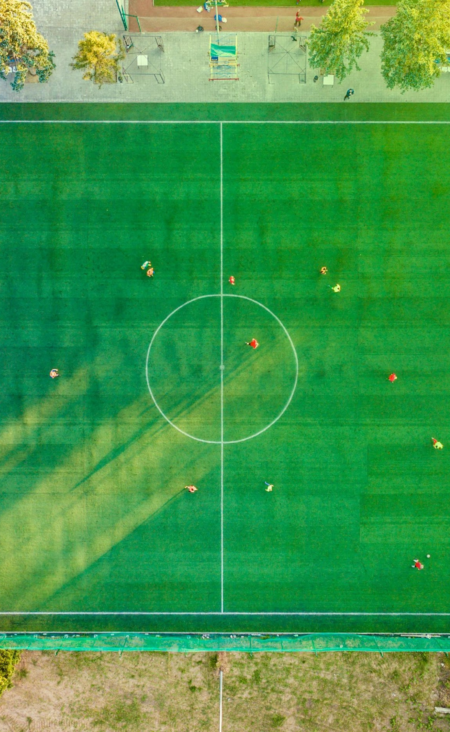
2. President’s Report
HIGHLIGHTS
Good turn out in Youth programming: Summer, Fall, and Winter
U8 Development: ~ 30 participants
Adult: strong numbers plus new programming (Men’s Only Pick Up- Mondays at 7pm and Men’s Open Age Select Team)
Women’s League continues to be a success
Soccer day
Great volunteers in all areas
Amazing Club (and other) sponsors
Continued cooperation and coordination with BSC
Administrator: one for all three club

Slide 7

2. President’s Report (cont’d)
FUTURE CHALLENGES (Short- and Long-term):
Minor Soccer: service offering, coordinators and leader
Adult programming
Facilities: quality of fields and gym space
Sponsors: future club sponsors aren’t guaranteed and are hugely important
Changing of the guard…need new blood!
Notes:
One challenge that I have been meeting with around is house league: our very appreciated volunteer coaches often do not have soccer experience, which as the players get older it proves as a bigger challenge as we are trying ot develop their skills and love for soccer.
Over the years some of our adult programming has fallen through due to registration (lack of or late). Without knowing numbers until last minute, it is more challenging to secure the spaces and llow for balanced teams
The quality of the soccer fields in town continues to be an ongoing challenge. Despite an improving relationship between the club and the town, we struggle with their commitment/acknowledgement that the drainage at McCulley is significantly impacting the programs we are providing to the community, and restricts our ability to host tournaments/festivals, which could bring income into the community. An increasingly concerning barrier in this season particular is our access to indoor space: with new clubs/community groups being established (which is great for the community!) and the priority of spacing going to youth over adults, we are very limited in appropriate sized spaces for indoor soccer.

Slide 8






3. Report re: MUFC
Recall MUFC is a separate legal entity. It is “owned” by HSC and BSC.
It is run by a board of 8 individuals: 4 nominees from HSC and 4 nominees from BSC.
Nominees from HSC are Steph N, Glen D, Joe M, Chuck L
This past year we had 13 teams between U9 - U18 Divisions
2 of those teams competed in the IModel Division
This upcoming year, we plan to have 12 rep teams in the following age groups: U11 Girls, U12 Girls, U13 Girls, U15 Girls, 2-U10 Boys, 2-U11 Boys, U12 Boys, U13 Boys, U15 Boys and U18 Boys.
Huge thank you to our club and team sponsors:

Slide 9
3. President’s Report re MUFC (cont’d)
Some good improvements this year such as:
  development teams and time with Coach Ray (both direct and indirect)
  goalie training with Daniel Zangoli
  partnership with SportLab re strength and conditioning
  VEO
  Overall, the work and cooperation between the three clubs has been incredible.
Thanks to all the coaches, board members and other volunteers for the countless hours.

Slide 10


Slide 11


Slide 12
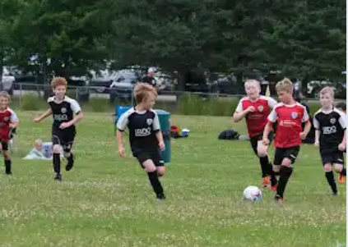
4. Minor Soccer Report
Number of Winter (Indoor) Youth players = 59 (60)
  50 Boys, 9 Girls (43 Boys, 11 Girls )
Number of Summer Youth HL players = 543 (577)
  U4 = 79 (83)
  U6 girls = 41 (56) ; U6 boys = 79 (75)
  U8 girls = 37 (43); U8 boys = 83 (90)
  U10 girls = 28 (39); U10 boys = 68 (68)
  U12 girls = 38 (30); U12 boys = 39 (41)
  U15 co-ed = 30 (22)
  U8 Development = 21 (30)
Number of Fall League players = 79 (101)
Total players = 681 (711)
Three Program Coordinators were hired to run the house league programs; big thanks to them. Hiring already for next year!

Slide 13
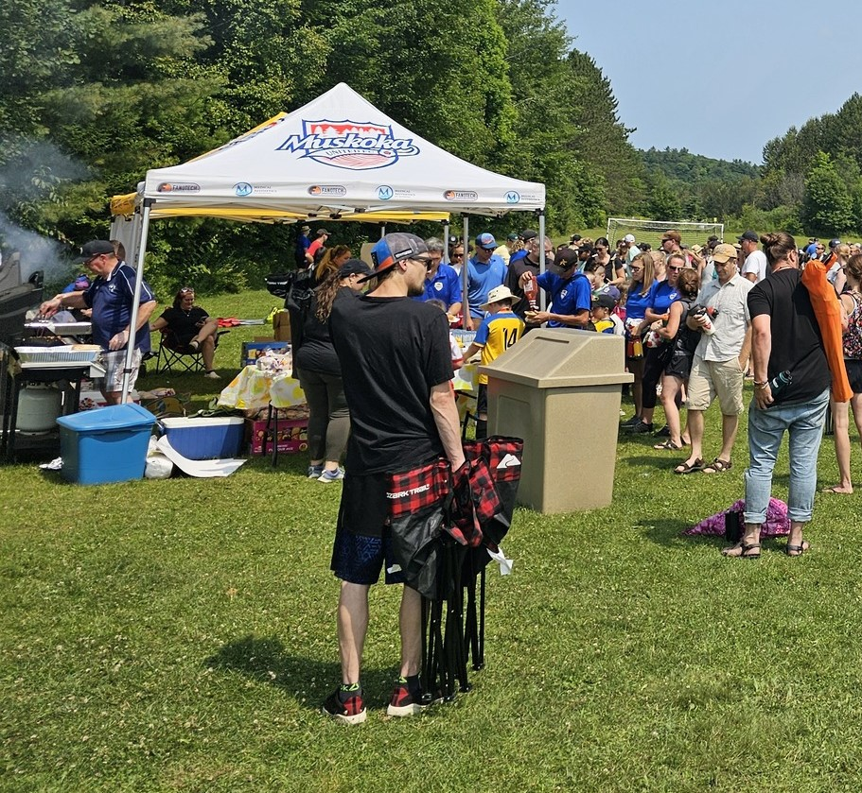
4. Minor Soccer Report (cont’d)
Soccer day was held on Saturday July 26th
  Bullock’s Independant donated all the food for BBQ - $1108 ($483) raised and donated to Children’s Foundation of Muskoka
  We also had games, additional displays (MUFC tent with Representatives)
Challenger Sports Camp ran July 28th to August 1st at McCulley North Fields
Registrations for Summer Camp (TOTAL = 68):
A HUGE thank you to all the volunteers that made house league and soccer day a success!

Slide 14
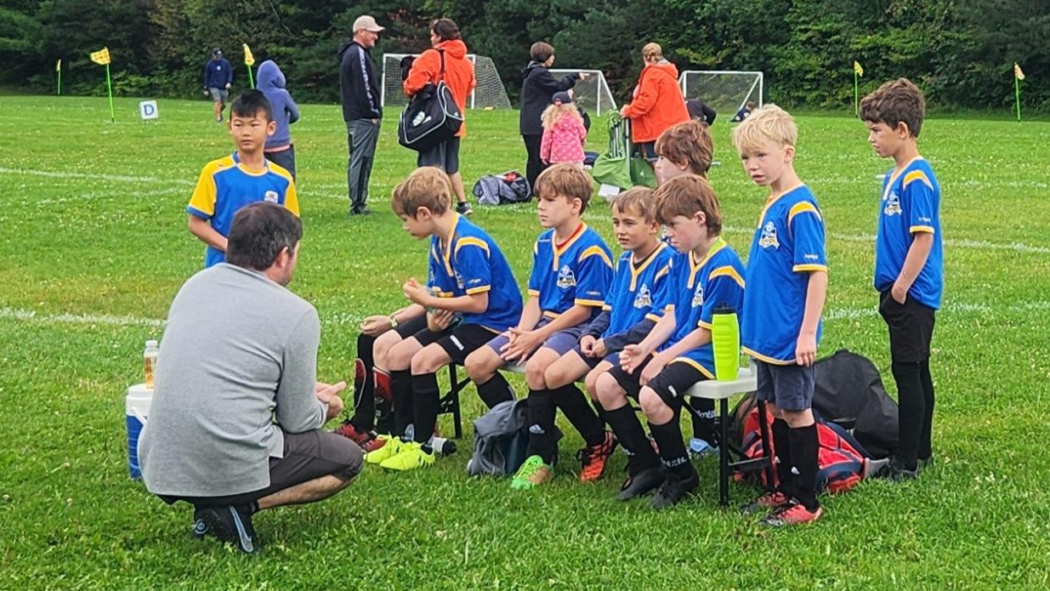
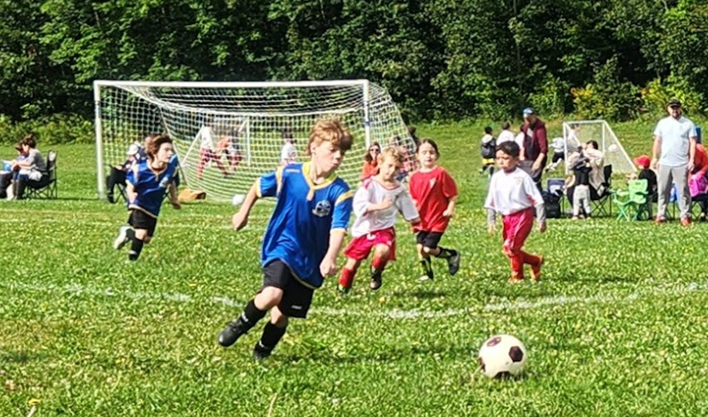
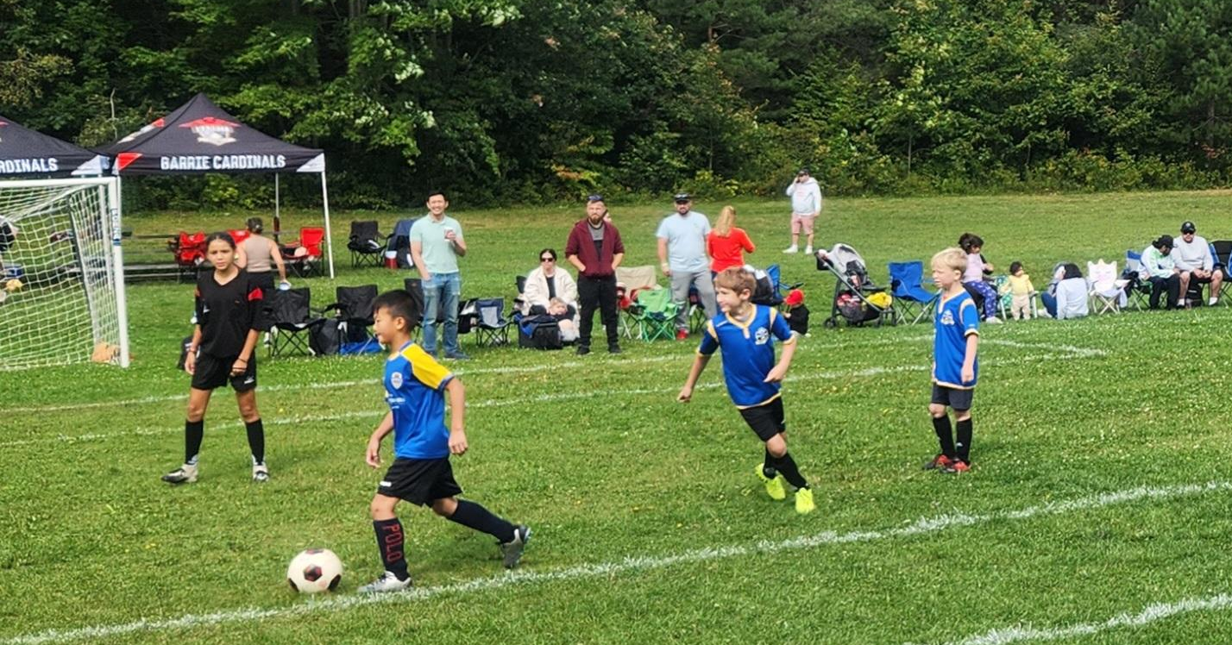
5. U8 Development Program
U8 Development Program = 21
Big thanks to Bill Anderson, Olivia Pol and Lauren Service for program delivery
Combination of 2017 and 2018 born players, co-ed
Program ran from May to August
Could not attend U8 Festivals this season

Slide 15
6. Adult Program Report
Programs | Registrations | Dates
Women’s 7v7 League | 48 (48) | May-July
Indoor Rec & Co-ed Pick-up Leagues | 70 (68) | November - April
Outdoor Experienced Co-ed League | 75 (72) | May - August
Outdoor Intermediate Co-ed 7v7 League |  | Did not run in 2025
Sunday Morning Only Co-ed Rec Pick up | 11 | May - October
Men’s Team |  | Did not play in 2025
Men’s Only Pickup (Sundays) | 1 (21) | May - October
Carlos Burmeister Memorial Tournament |  | Did not happen in 2025
Thanks to Dave Caplan for stepping up and helping to coordinate the adult programs

Slide 16
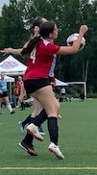
7. Women’s Coordinator Report
2025 was a milestone season for he Huntsville Women’s Soccer League with the acquisition of an annual league sponsor, David and Donna Buckley. This new sponsorship agreement. combined with our tradition team sponsors, gave the league an added financial boost leading to a better soccer experience for our members.
The Women’s League is made up of four teams of 12 players each, 48 registered players in total, competing weekly in a 7v7 format.
This last season field dimensions were modified (larger) with hopes for a safer game and the changes proved successful.
As like previous years, the season was played over ten weeks with each team competing in eleven games and a champion crowned at the completion.

Slide 17
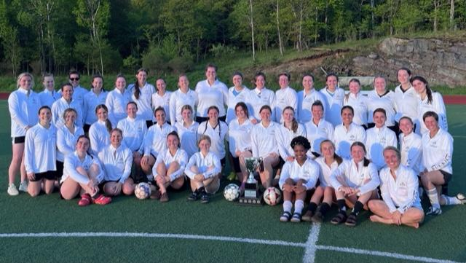
7. Women’s Coordinator Report (Con’t)
New for 2026 will be the expansion of the league to a 6 team format. This is in response to the growing popularity and the desire to provide a continued great soccer experience for our existing and future membership.
Huntsville FC est. 2016, made up of advanced adult female players, continued their successful run. Weekly training throughout the winter and summer months proves highly beneficial to the overall improvement of skill level and team comradery.
The Women’s Coordinator provides a ‘voice’ for our female members and all have been encouraged to contribute their thoughts and suggestions through me, for action by HSC.

Slide 18

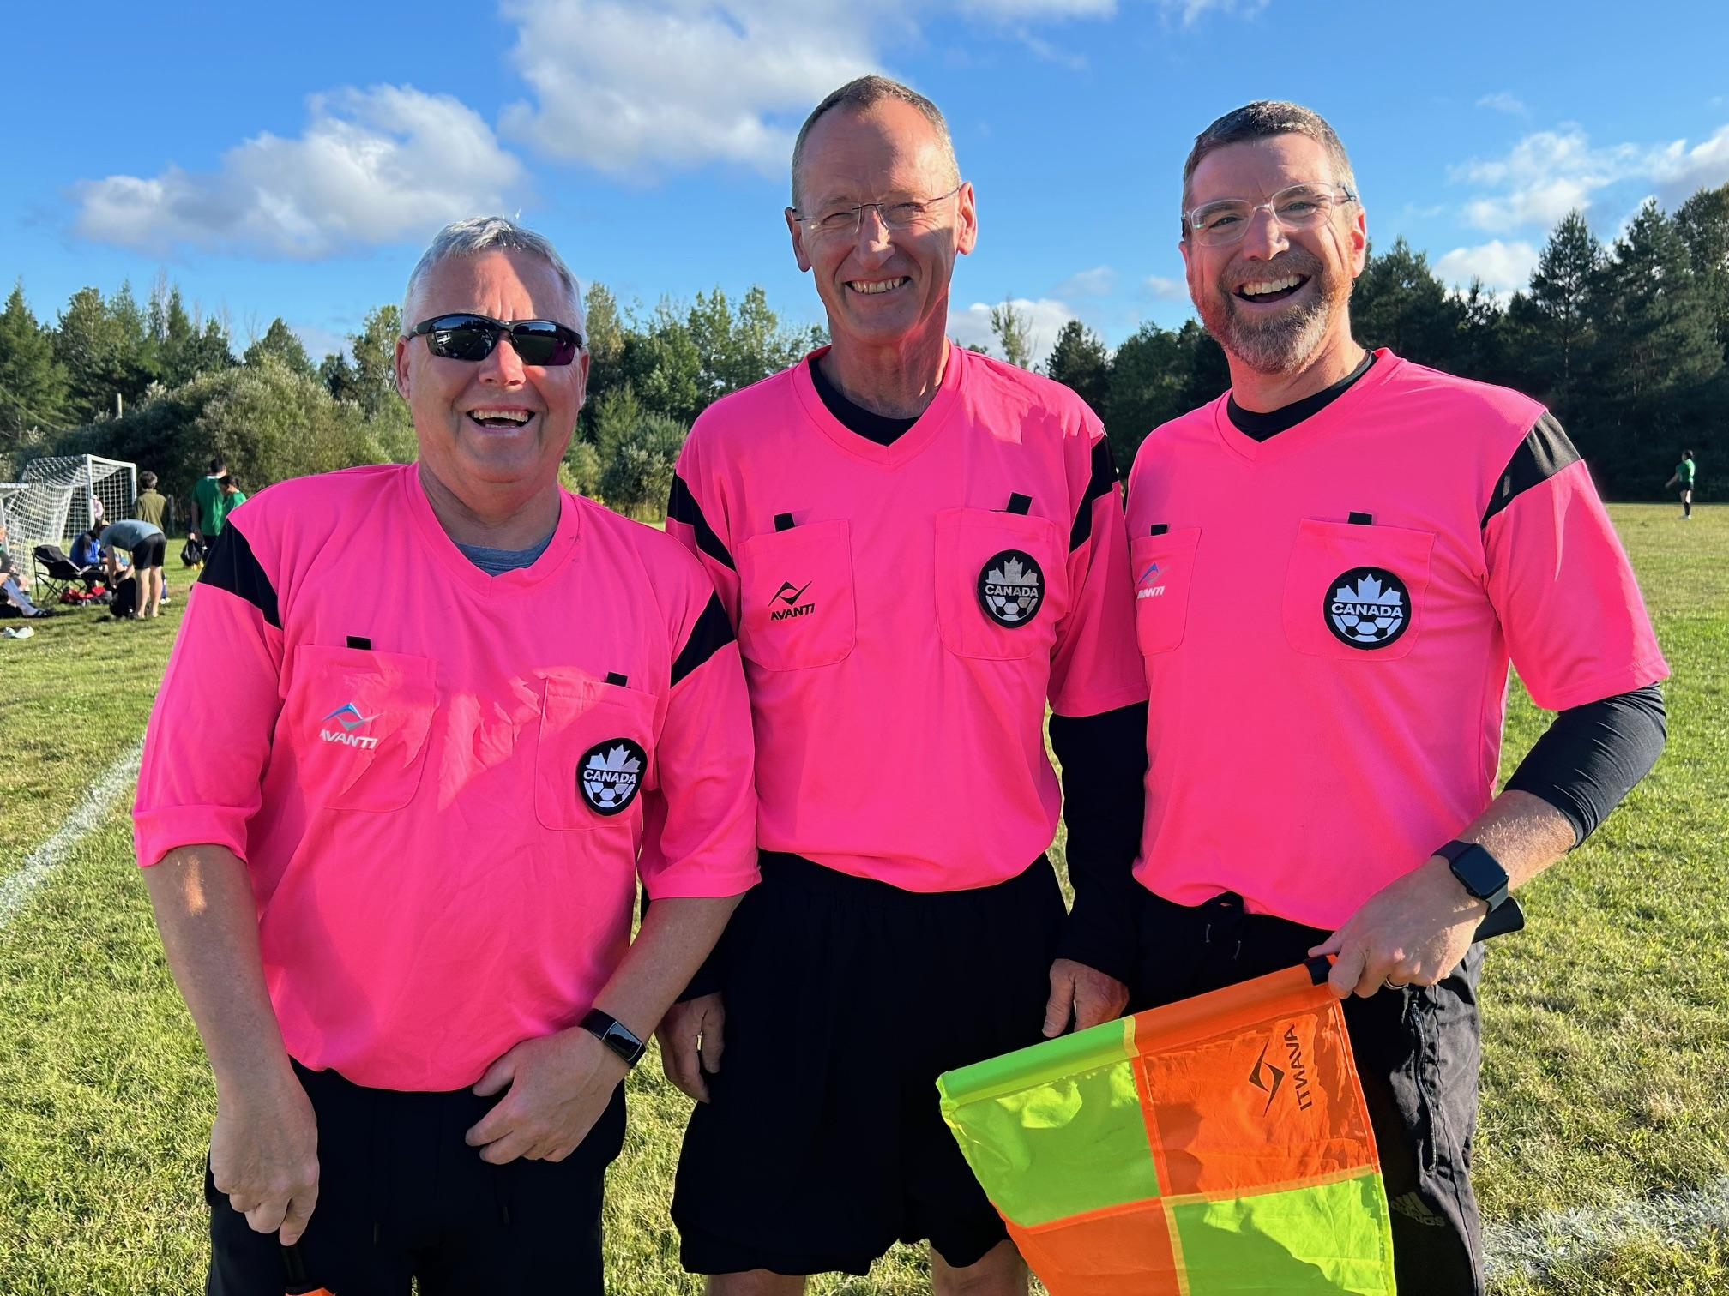
8. Head Referee Report
In 2025, the Huntsville Soccer Club had a total of 18 Match Officials who were either returning from last season or newly signed up through the online Ontario Soccer Association Referee Course.
Our soccer season ran from May 19th to August 28th, 2025 with a total of 201 games including a House League season, the popular House League Soccer Day, a variety of adult programs and the HDSA U8 Festival.
In addition to this total, there were 75 competitive games for Muskoka United Football Club, a continued collaboration between Huntsville and Bracebridge.
Match Officials at McCulley South
Glen, Mike & Chuck

Slide 19

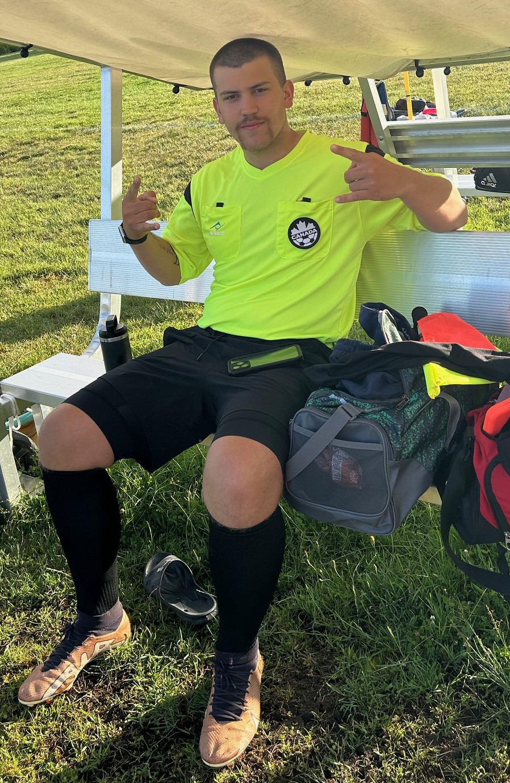
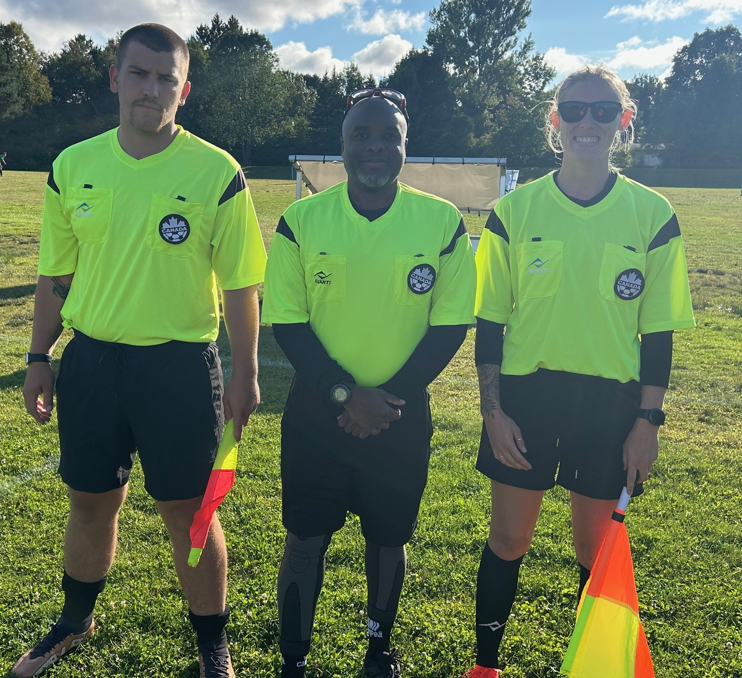
8. Head Referee Report (cont’d)
We were extremely successful in filling our match official assignments for 2025
(Ref and A/R’s, a rate of 96.2%)
Huntsville SC is always interested in bringing along new referees through our in-house mentor program, please contact us through our website to register for 2026.
New Match Official
Alfie Napper
Ready for game action
Alfie, Marlon & Kayla

Slide 20
9. Treasurer Report
The Club is reporting a net income of $8,569 for the 2025 Aug 31 fiscal year compared to $8,887 (formerly $19,317 and changed due to field rental expense accrual) in the 2024 Aug 31 fiscal year.
Revenue income stream breakdown is as follows:
Registration fees 80%
Sponsorships 14%
Interest income (savings), grants (Children’s Foundation of Muskoka), and donations 6%
Expenses for the Club continue to be kept relevant and sustainable. The largest typical costs are wages, referee fees, uniforms, field rental and membership fees for HDSA and OSA.
Donations made by the Club:
HSC member GoFundMe for injury recovery - $200
2025 Female Athlete Bursary - $500 for a member of HSC or MUFC that will be pursuing post-secondary education
Assets are $294,571 for the 2025 FY and are comprised of cash and GIC accounts. Liabilities are $31,982 for the 2025 FY and are comprised of accounting accruals for referee payroll, audit fees, admin salary, and field rental. Net assets stand at $262,589.
The Board is in the process of updating and expanding HSC’s sponsorship program so that we can keep registration fees as low as possible.

Slide 21
9. Financial Audit; Auditor
HSC has received our financial audit from BDO for the last fiscal year. Copies of the financial statements are available on request.
The statement summary from BDO is as follows:
We have audited the financial statements of Huntsville Soccer Club (the Club), which comprise the statement of financial position as at August 31, 2025, the statements of operations and net assets and cash flows for the year then ended, and notes to the financial statements, including a summary of significant account policies.
In our opinion, the accompanying financial statements present fairly, in all material respects, the financial position of the Club as at August 31, 2025, and its results of operations and its cash flows for the year then ended in accordance with Canadian accounting standards for not-for-profit organizations.
APPOINTMENT OF AUDITOR: MOTION

Slide 22




10. 2025 Club Sponsors

Slide 23






10. 2025 Adult and WL Sponsors
David and Donna Buckley

Slide 24
11. Tonight’s Elections
The following positions are up for election:
*Nominations can be made from the floor for a position where there is no one nominated
POSITION | NOMINATED
Vice President
Equipment Manager / At Large | Hadyn Kirby
Adult Coordinator | Dave Caplan
**Acclaimed

Slide 25
11. Support Positions
To assist the Executive, the following positions have been created - please spread the word about these vacancies:
POSITION | VOLUNTEER
Assistant Treasurer | Vacant
Sponsorship Manager | Vacant
Assistant Minor Soccer | Vacant
Assistant Adult Coordinator | Vacant

Slide 26
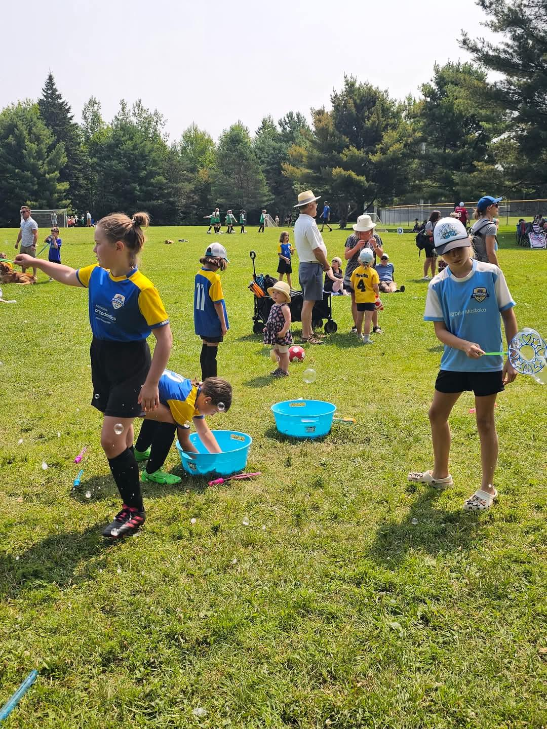
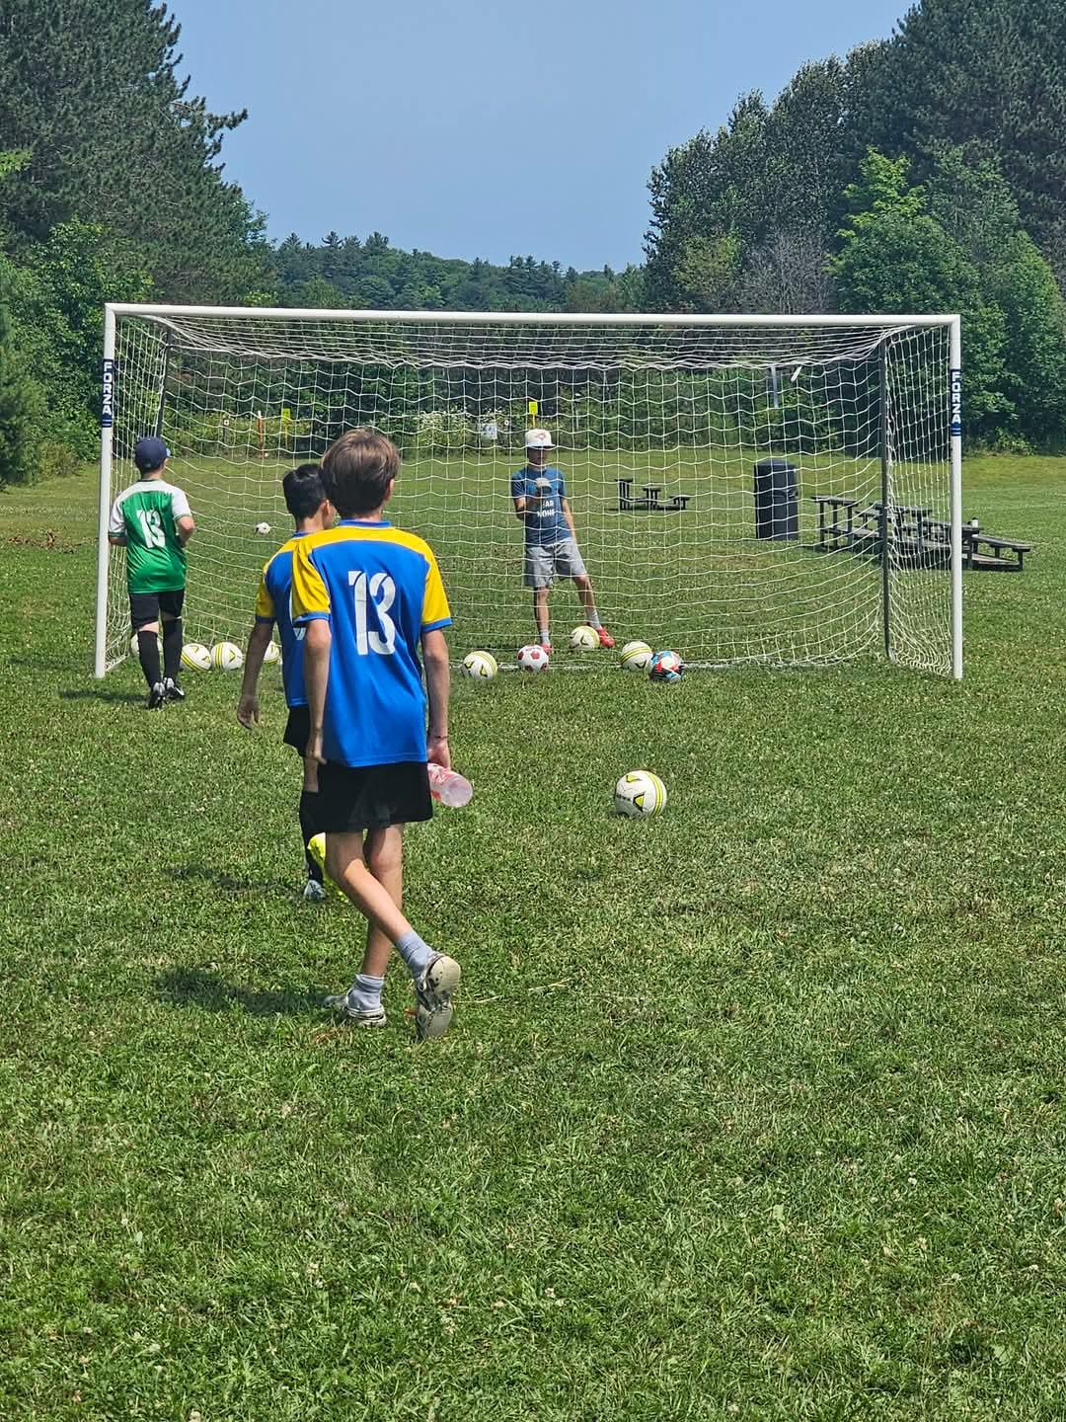
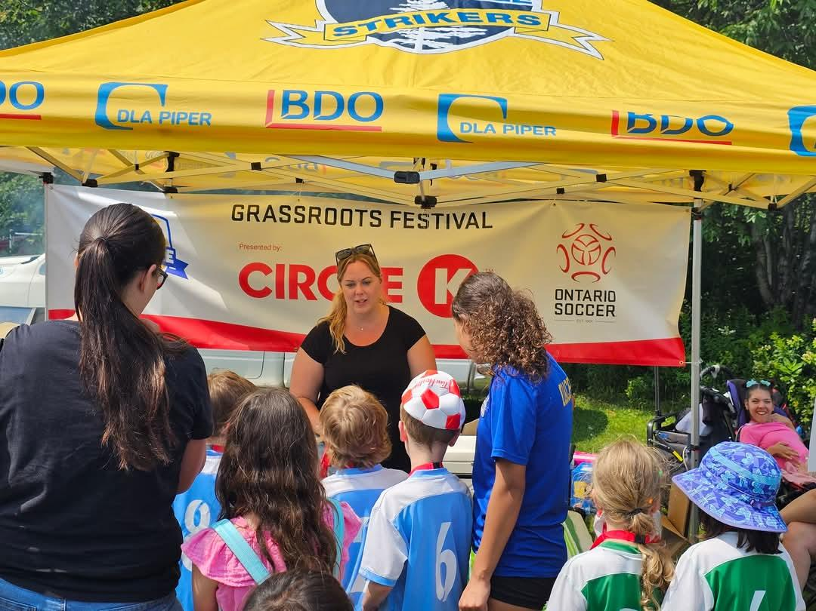
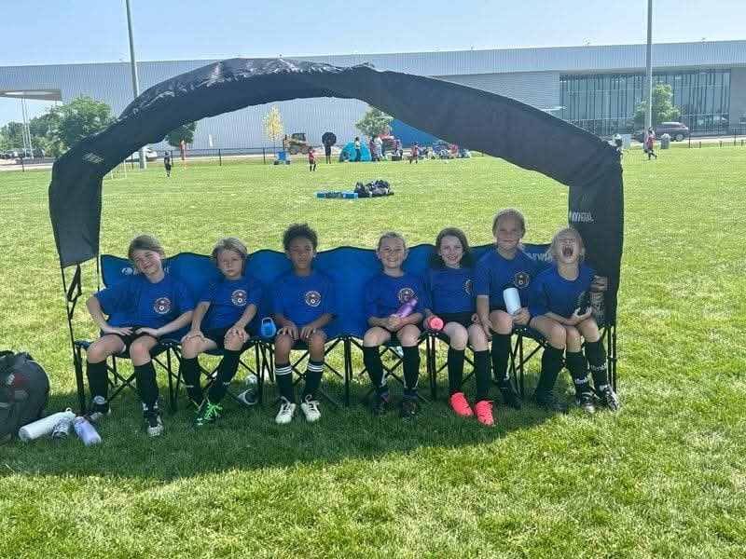
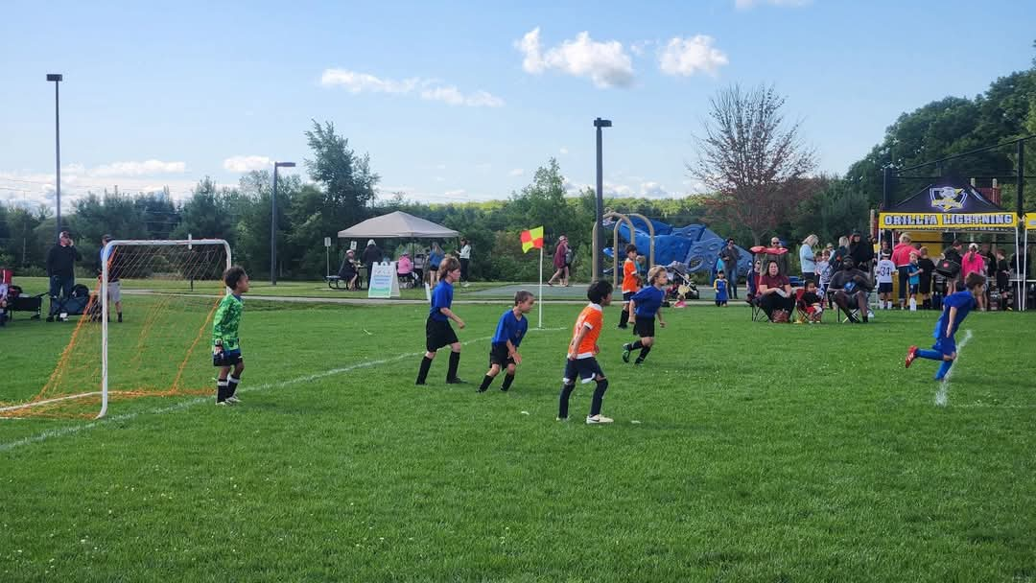
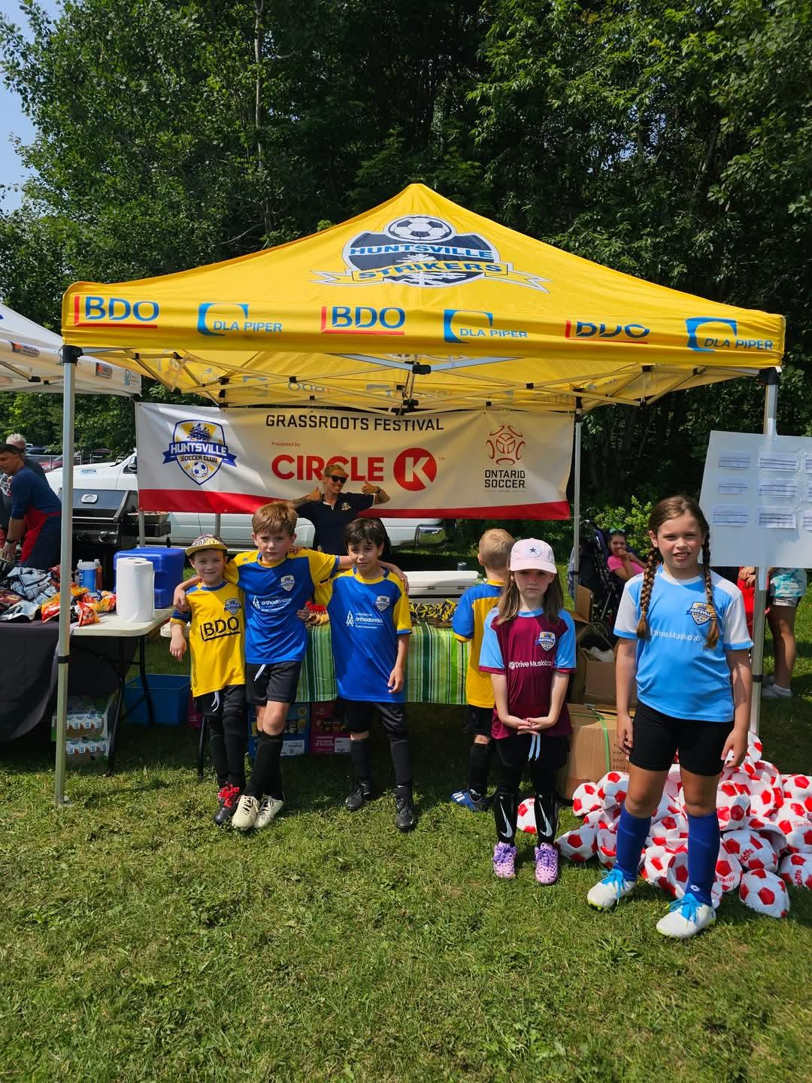
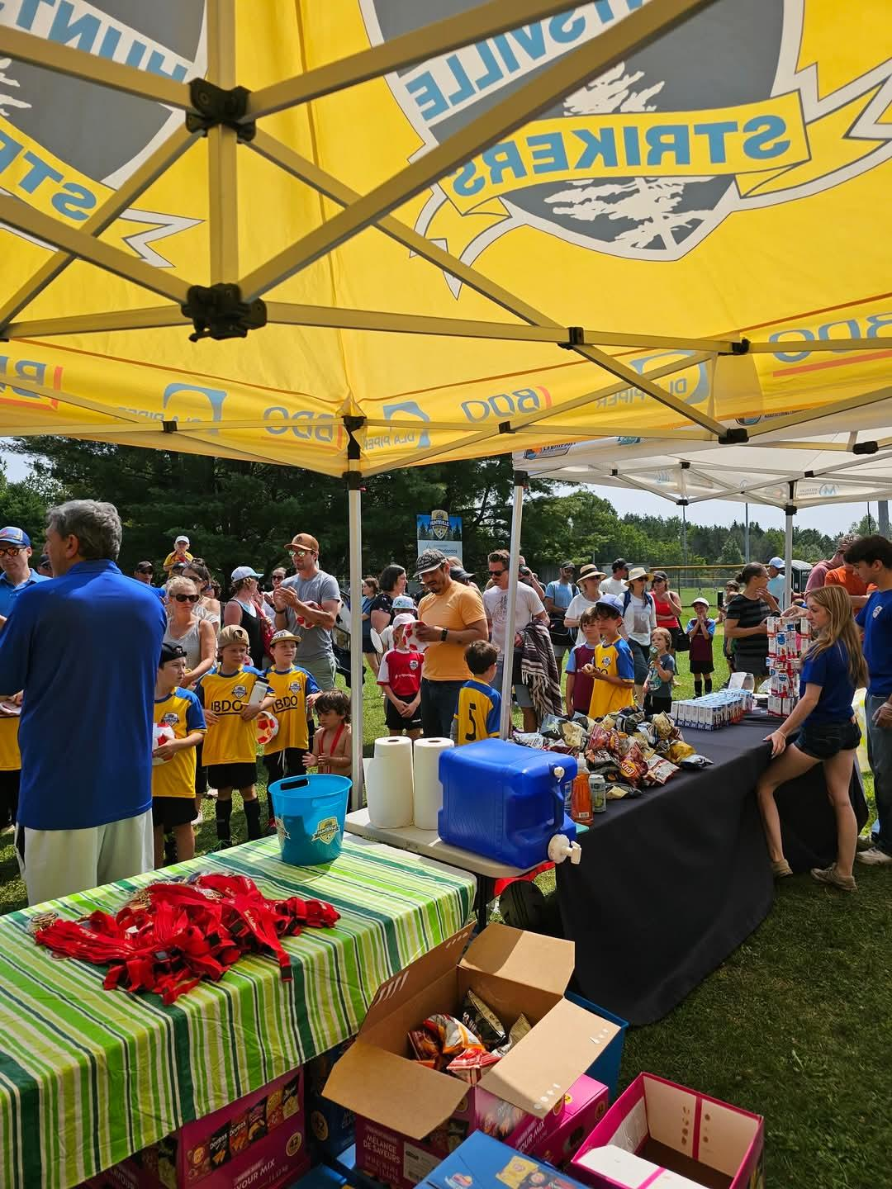
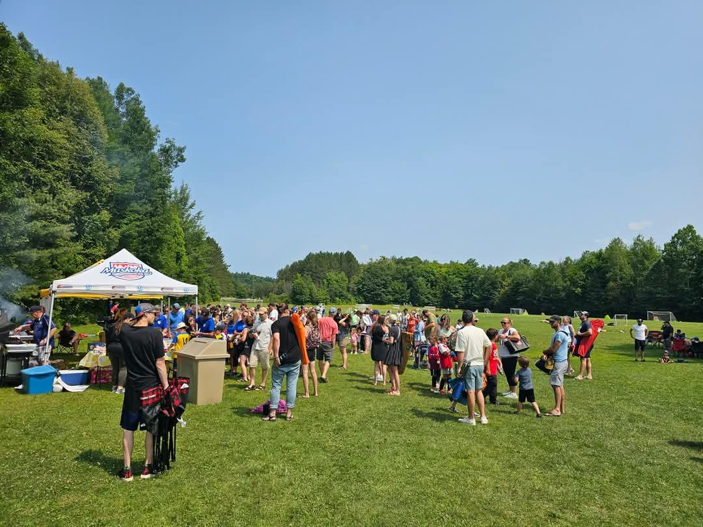
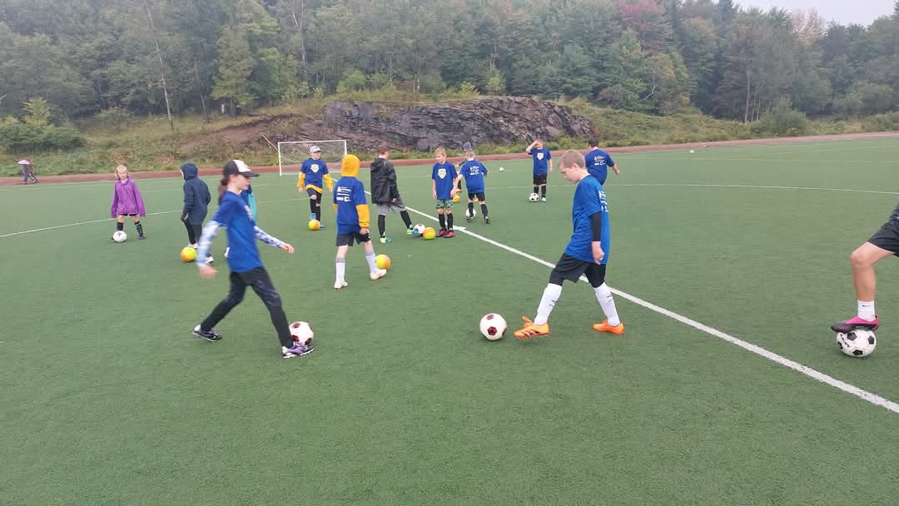
12. Q&A

