Slide 1
2024 AGM
Huntsville Soccer Club
Annual General Meeting
March 12, 2025
8:00pm

Slide 2
Welcome
Welcome to the Huntsville Soccer Club’s Virtual Annual General Meeting!
Call to order.
Minutes being taken by Marlon, our Club’s Secretary.
Notice was provided in accordance with our Bylaws. We had to adjourn to allow for financials to be completed but we are ready to go.
Roll Call (including proxies).
Confirm that quorum (which is 10 members) has been met.
We therefore have a validly constituted meeting and can proceed with tonight’s business.
First order of business: approve last year’s minutes.
Second order of business: approve Agenda.

Slide 3
Acknowledgement
We will begin this AGM by acknowledging that we play soccer on land that has been inhabited by Indigenous Peoples from the beginning. In particular, we acknowledge the traditional territory of the Ojibway, Chippewa and Algonquin peoples. We recognize and deeply appreciate their historic connection to this place. We also recognize the contributions First Nations, Metis, Inuit and other Indigenous Peoples have made, both in shaping and strengthening this community in particular, and our province and country as a whole.

Slide 4
Agenda
Club Executive
President’s Report
Report re MUFC
ONCA
Minor Soccer Report
U8 Development Report
Adult Coordinator Report
Women’s Coordinator Report
Head Referee Report
Treasurer Report; Financial Audit; Auditor
2024 Club and Team Sponsors
Election
2025 Club Sponsors
Q&A

Slide 5
Club Executive
The Huntsville Soccer Club executive board consists of several voting and non-voting positions.
Every two years, half of our voting positions come up for re-election.
Below are our voting positions on the board:
*** Positions open for re-election are
** D&I Officer and Rep Coordinator roles to be removed from the board and replaced with two At-Large Director positions. Treasurer and Minor Coordinator were vacated and filled mid-term.
Up for re-election |  | Second of a two year term
President | Ted Maduri | Vice President | Chris Occhiuzzi
Head Referee | Glen Duffield | Treasurer | Anne McNally **
Secretary | Marlon Jordan | Adult Coordinator | Melanie Mercier
Womens Director | Mike Hill | Minor Coordinator | Kayla Bauer **

Slide 6
2. President’s Report
HIGHLIGHTS
Virtually sold out across the board in Youth programming: Summer, Fall and Winter
Adult: strong numbers plus new programming (Men’s Only Pick Up- Mondays at 7pm and Men’s Open Age Select Team)
Women’s League continues to be a success
Soccer day was the best I’ve seen as President / VP
U8 Development: ~ 30 participants
Great volunteers in all areas
Amazing Club (and other) sponsors
Continued cooperation and coordination with BSC
Administrator: one for all three clubs–sign of things to come
Graham Pollington / Pollington Field

Slide 7
2. President’s Report (cont’d)
FUTURE CHALLENGES (Short- and Long-term):
Minor Soccer: service offering, coordinators and leader
Treasurer
Adult programming
Facilities: quality of fields and gym space
Sponsors: future club sponsors aren’t guaranteed and are hugely important
Changing of the guard…need new blood!

Slide 8
3. Report re: MUFC
Recall MUFC is a separate legal entity. It is “owned” by HSC and BSC.
It is run by a board of 8 individuals: 4 nominees from HSC and 4 nominees from BSC.
Nominees from HSC are Steph N, Glen D, Chris O, Chuck L→I’ve already given up my MUFC role
Milestone: 2024 was the first year that MUFC ran the Development Program.
This past year we had 276 players and 17 teams between U9 - U21 Divisions
We had 16 of the 17 teams compete in the HDSL and one team compete in OWSL
This upcoming year, we plan to have 15 rep teams in the following age groups: U9 Girls, U11 Girls, U12 Girls, U13 Girls, U14 Girls, U15 Girls, U17 Girls, U9 Boys, U10 Boys, U11 Boys, U12 Boys, U13 Boys, U14 Boys, U15 Boys and U17 Boys.
Huge thank you to our club and team sponsors:

Slide 9
3. President’s Report re MUFC (cont’d)
Some good improvements this year such as:
development teams and time with Coach Ray (both direct and indirect),
goalie training,
partnership with SportLab re strength and conditioning.
Overall, the work and cooperation between the two clubs has been incredible.
But….growing pains still exist:
fees;
level of competition (is “good but not great” good enough?); and
volunteer burnout (changing of the guard).
It takes so much time to have three boards to run soccer in Huntsville and Bracebridge; likely not sustainable. Merger: inevitable?
Thanks to all the coaches, board members and other volunteers for the countless hours.

Slide 10
MUFC Development Team Sponsors 2024

Slide 11
MUFC Rep Team Sponsors 2024

Slide 12
MUFC Rep Team Sponsors 2024 (cont’d)

Slide 13
4. ONCA: Articles of Amendment and By-laws
Amendment of articles
The Letters Patent be amended as follows‎: ‎
To delete all of the special provisions and replace them with the following: ‎
The Corporation is authorized to establish three classes of members, consisting of:
Regular Members, who shall be entitled to receive notice of, attend, speak at and vote at all meetings of the members of the Corporation class of members.
Honourary Members, who shall be entitled to receive notice of, attend, speak at, but shall not be able to vote at meetings of the Members of the Corporation.
Life Members, who shall be entitled to receive notice of, attend, speak at, but shall not be able to vote at meetings of the Members of the Corporation.
Commercial purposes, if any, included in the articles are intended only to advance or support one or more of the non-profit purposes of the Corporation. No part of a Corporation’s profits or of its property or accretions to the value of the property may be distributed, directly or indirectly, to a member, a director or an officer of the Corporation except in furtherance of its activities.
Upon the dissolution of the Corporation and after satisfying the interests of its creditors in all its debts, obligations and liabilities, its remaining property shall be distributed to one or more organizations with similar purposes to its own as determined by the board at the time of dissolution.
To provide that the number of directors of the Corporation shall be a minimum of three (3) and a maximum of twelve (12).

Slide 14
4. ONCA (cont’d)
2. Articles of Amendment which give effect to the above amendments be approved and filed with ‎the Ministry of Public and Business Service Delivery (the “MPBSD”), together with any other such ‎amendments as may be required by the MPBSD or the Office of the Public Guardian and ‎Trustee‎.
3. Any two directors of the Corporation are authorized to execute the Articles of Amendment and to take any additional and ancillary action necessary to give effect to these resolutions, including signing other documents and instruments.
4. The persons executing the Articles of Amendment are hereby authorized and directed to make such technical changes in the Articles of Amendment as may be required by the MPBSD and the Office of the Public Guardian and Trustee, with no further recourse to the board or members to approve or confirm such changes, and any such amendments made by such persons shall be conclusive evidence of the need to make such amendments and are hereby ratified, sanctioned and approved.
Amendment to By-laws
5. All existing by-laws of the Corporation be repealed and replaced with By-Law No. 1 a copy of which was enclosed ‎with the Notice of Meeting for this meeting of members‎.

Slide 15
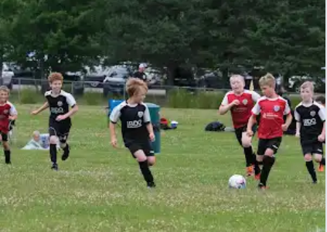
5. Minor Soccer Report
Number of Winter (Indoor) Youth players = 54
43 Boys, 11 Girls
Number of Summer Youth HL players = 526
U4 = 62
U6 girls = 56; U6 boys = 75
U8 girls = 43; U8 boys = 90
U10 girls = 39; U10 boys = 68
U12 girls = 30; U12 boys = 41
U15 co-ed = 22
Number of Fall League players = 101
Total players = 681
Two Program Coordinators were hired to run the house league programs; big thanks to them. Hiring already for next year!

Slide 16
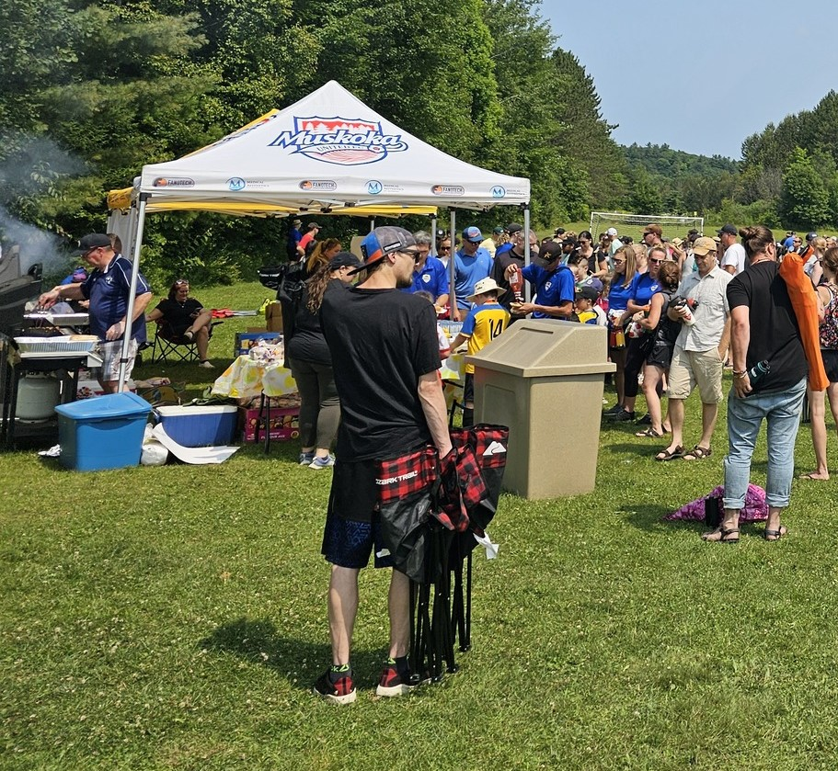
5. Minor Soccer Report (cont’d)
Soccer day was held on Saturday July 27th
Bullock’s Independant donated all the food for BBQ - $483 raised and donated to Huntsville Hospital’s MRI fund
Sue Morrison donated freezies
We also had games, additional displays (MUFC team fundraisers, etc)
Challenger Sports Camp ran July 29th to August 2nd at McCulley North Fields
Registrations for Summer Camp (TOTAL = 61):
Tiny Tikes =2
Half Day = 16
Full Day = 43
A HUGE thank you to all the volunteers that made house league and soccer day a success!

Slide 17
6. U8 Development Program
U8 Development Program = 30
Big thanks to Andrew MacDonald and Steph Nasturzio
Combination of 2016 and 2017 born players, girls & boys
Program ran from May 24th to August 25th
Attended Three U8 Festivals with 2 teams attending each festival in Orillia, Innisfil and Huntsville.

Slide 18
7. Adult Coordinator Report
Programs | Registrations | Dates
Women’s 7v7 League | 48 | May-July
Indoor Rec & Co-ed Pick-up Leagues | 68 | November - April
Outdoor Experienced Co-ed League | 72 | May - August
Outdoor Intermediate Co-ed 7v7 League | 21 | May - August
Sunday Morning Only Co-ed Rec Pick up | 11 | May - October
Men’s Team | 16 | May - July
Men’s Only Pickup (New) | 21 | May - October
Carlos Burmeister Memorial Tournament | 50 | Sat, Sept 14th
Adult Coordinator: Melanie Mercier / Assistant: George Johns

Slide 19
6. Adult Coordinator Report (cont’d)
2023/24 Indoor Season
Tuesday Experienced Division One League- 6-10pm HHS Gym C. Three one hour time slots for games. 6 teams of 6-7 players. Started the season first week of November, played pick up until the Holiday break in an effort to assist with fair team building to begin the new year. Well attended.
Thursday Intermediate Division Two Pick up- 8-10pm HHS GYM C- Low registration numbers but consistent turn out each week.
Thursday Adult Teams Only Pick up- New* 8-10pm HHS GYM AB- Well attended. Competitive.
2024 Outdoor Season- McCulley Fields.
Intermediate Division Two Pick up - Wednesdays @ 7pm. 7v7 format reflected registration interest. Consistent turnout each week. Had some welcome late registrations to boost numbers. Finished 10 week season with pizza and positive feedback. All games were officiated.
Experienced Division One League- Thursdays @ 7pm. 4 Teams of 15- 16 players. Once again started the season with an Introduction night of pick up games where players could meet/re-unite and coordinators could assess skill to assist in team organizing prior to season start. Competitive season with more carded fouls/incidents and suspensions than in previous years. Lower registration numbers a concern, very few under age 30. All games had a Referee and 1 or 2 Assistant Referees. Field Conditions were poor and responsible for unnecessary play errors and increased risk of injury to players. Town is working on improving it.

Slide 20
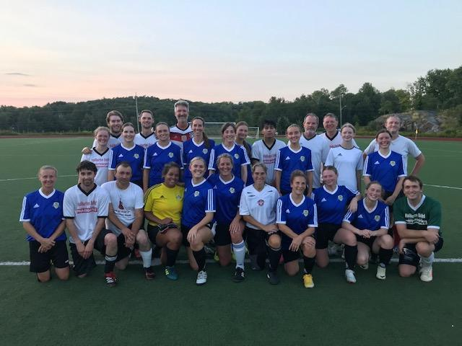
7. Adult Coordinator Report (cont’d)
New* Men’s Only Pick Up- Mondays at 7pm, May-October. Well attended. Mix of drills, pick-up
games and friendlies with other HSC teams. Growing interest and will return in 2025.
Sunday Only- 10am, pickup at Conroy and McCulley. Numbers dropped significantly this year. Sundays were offered as a complimentary add-on to league registrations. Not officiated.
New* Men’s Open Age Select Team - Select Competitive Recreational travelling team 19+. Played in friendlies with neighbouring towns and a tournament in Kinston. Of to a great start, hopeful to join a league this coming season in North Bay or Barrie.
Carlos Tournament - Saturday September 14th, 7v7, Conroy Park, 2 fields, 50 players, 5 teams of 10. Pizza, prizes, music. Smaller registration numbers and slightly less money raised but still an excellent day with great weather. (Thanks Carlos!)

Slide 21
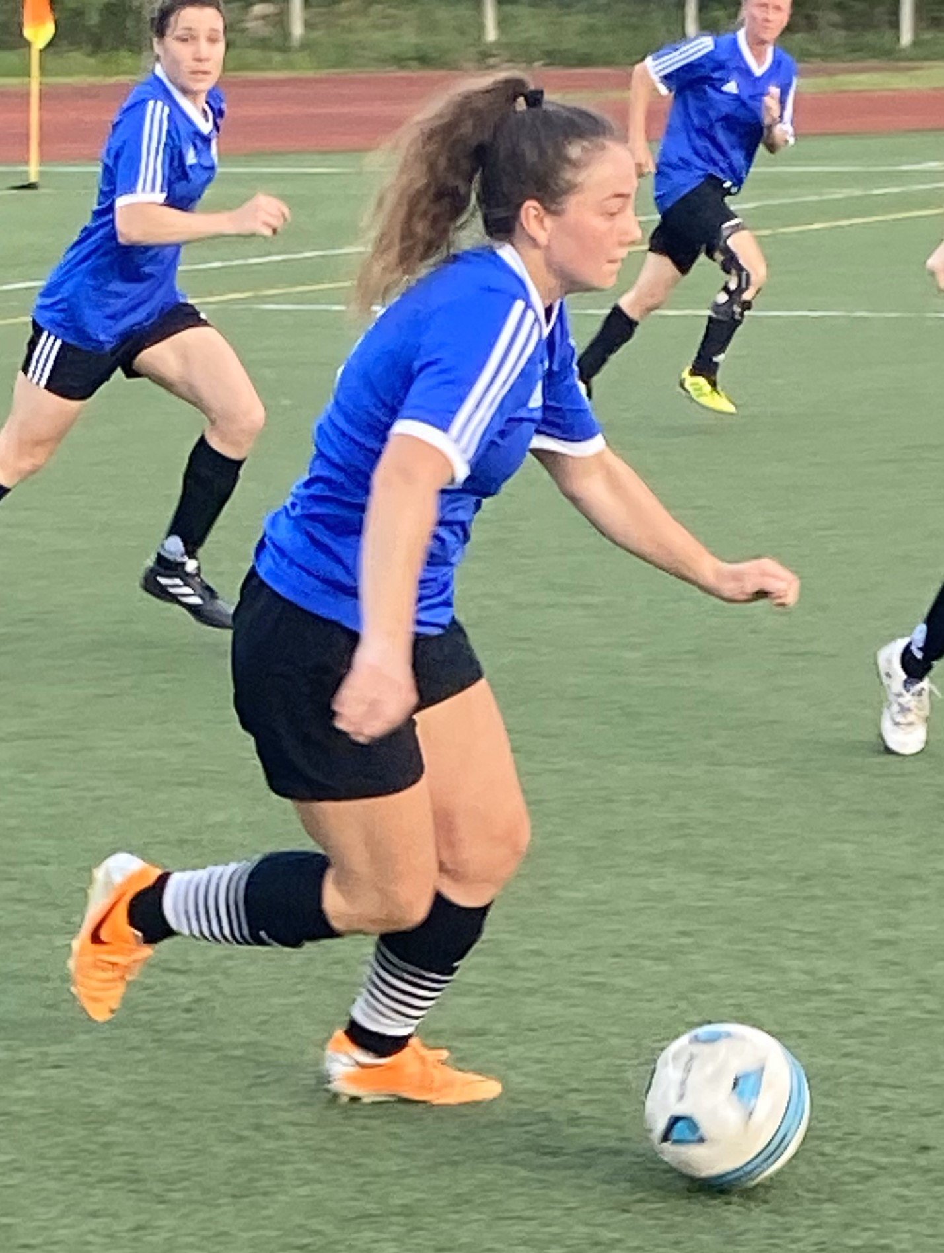
8. Women’s Coordinator Report
2024 marked the second successful season of the Huntsville Women Only Soccer League. The Women’s League was made up of four teams of 12 players each, 48 registered players in total, competing weekly in a 7v7 format. Rules and field dimensions were modified to accommodate this format. The season was played over ten weeks with each team competing in eleven games and a champion crowned at the completion.

Slide 22
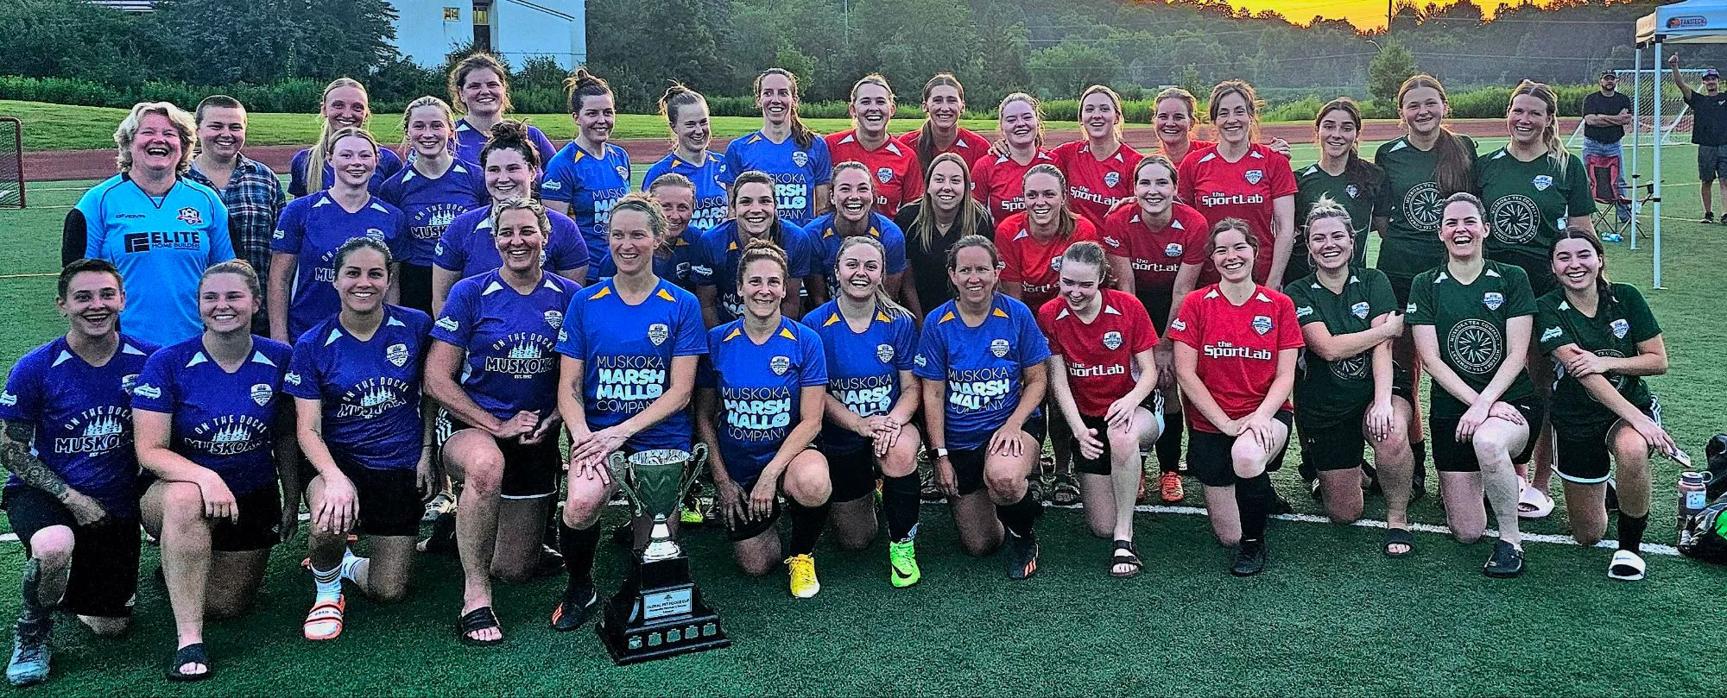
Through the help of HSC, we again this year, secured 4 team sponsors, all locally owned and operated businesses as well as 2 other contributors to help offset the cost of uniforms, prizes and the year-end champions trophy.
A suggestion for improvement is altering field dimensions to make the pitch larger in hopes that this will minimize the rash of contact injuries we saw this year.
Huntsville FC est. 2016, made up of advanced adult female players, continued their successful run. Weekly training throughout the winter and summer months proves highly beneficial to the overall improvement of skill level and team comradery.
The Women’s Coordinator provides a ‘voice’ for our female members and all have been encouraged to contribute their thoughts and suggestions through me, for action by HSC.

Slide 23
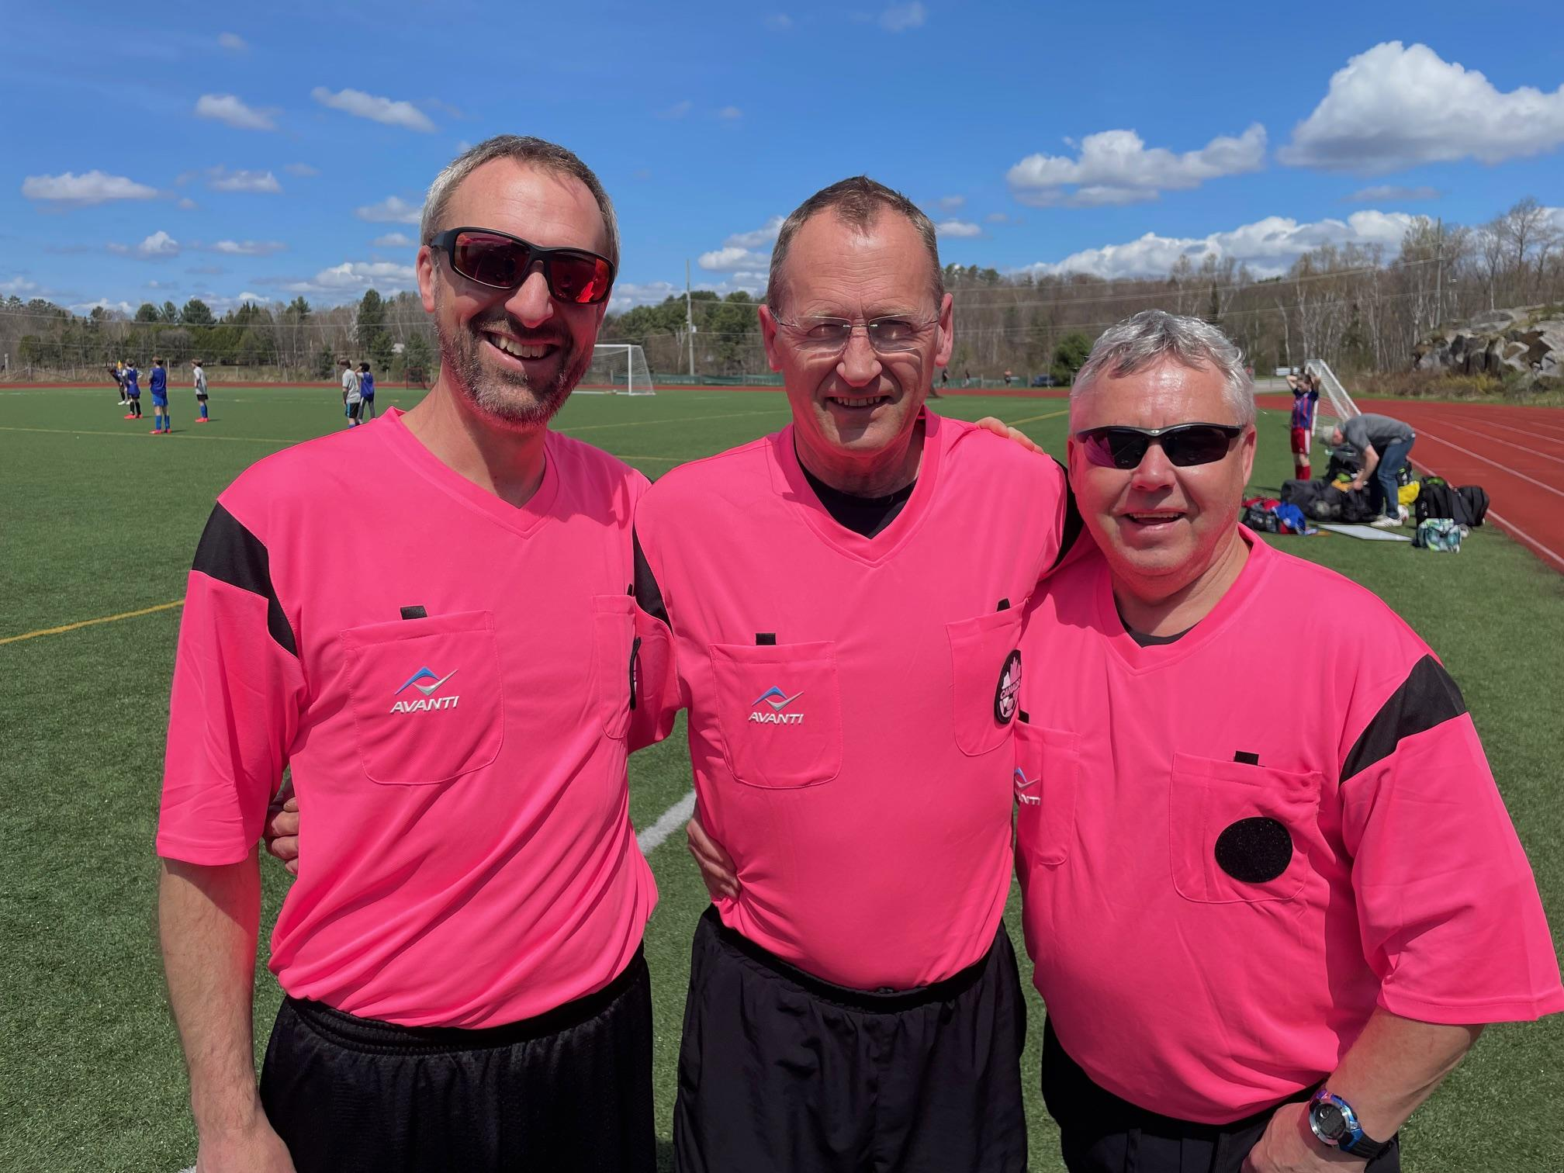
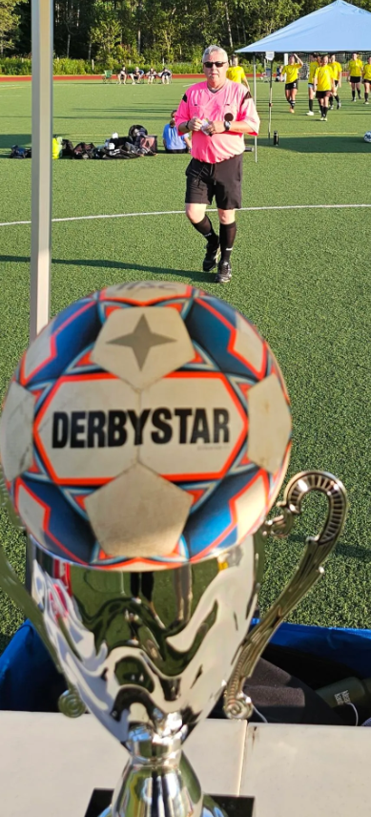
9. Head Referee Report
In 2024, the Huntsville Soccer Club had a total of 13 Match Officials who were either returning from last season or newly signed up through the online Ontario
Soccer Association Referee Course.
Our soccer season ran from May 20th to
August 25th, 2024 with a total of 196 games
including the popular House League Soccer Day,
the Carlos Burmeister Invitational tournament and
HDSA U8 Festival.
In addition to this total, there were 82 competitive games for Muskoka United Football Club, a continued collaboration between Huntsville and Bracebridge.
Match Officials at Conroy Park
Jez Bell, Mike Hill & Glen Duffield

Slide 24
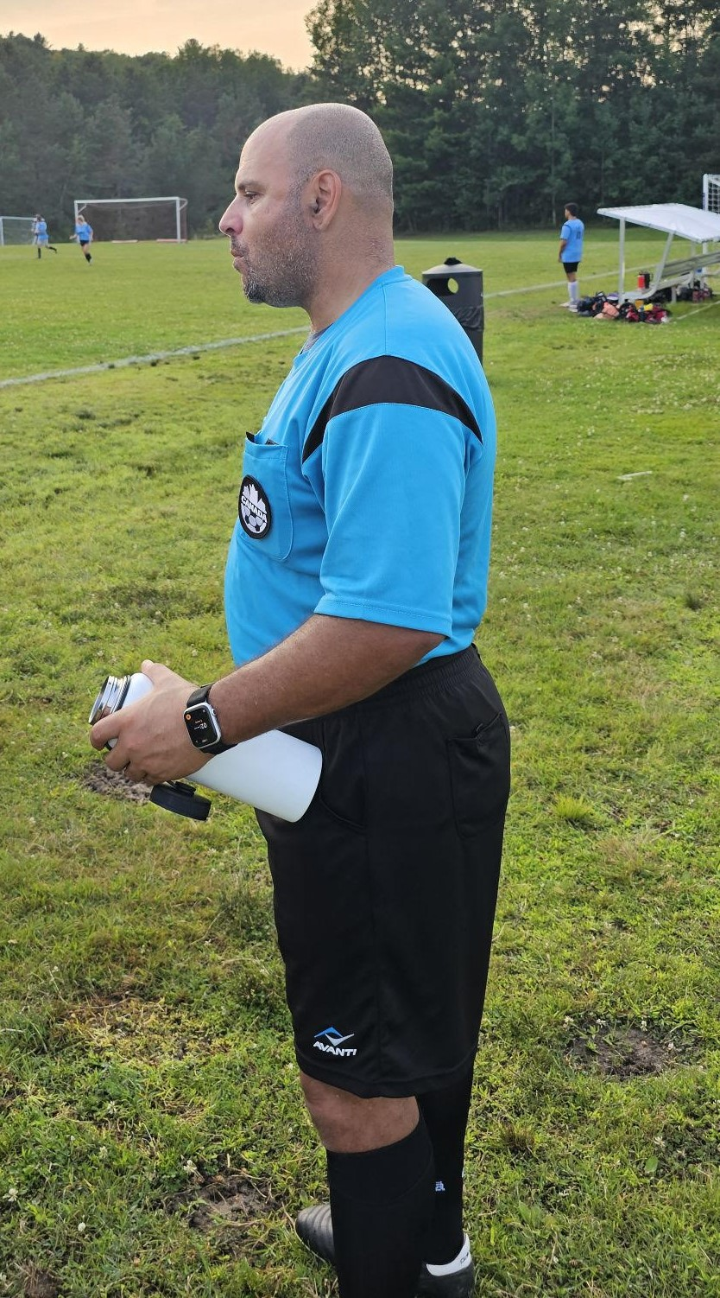
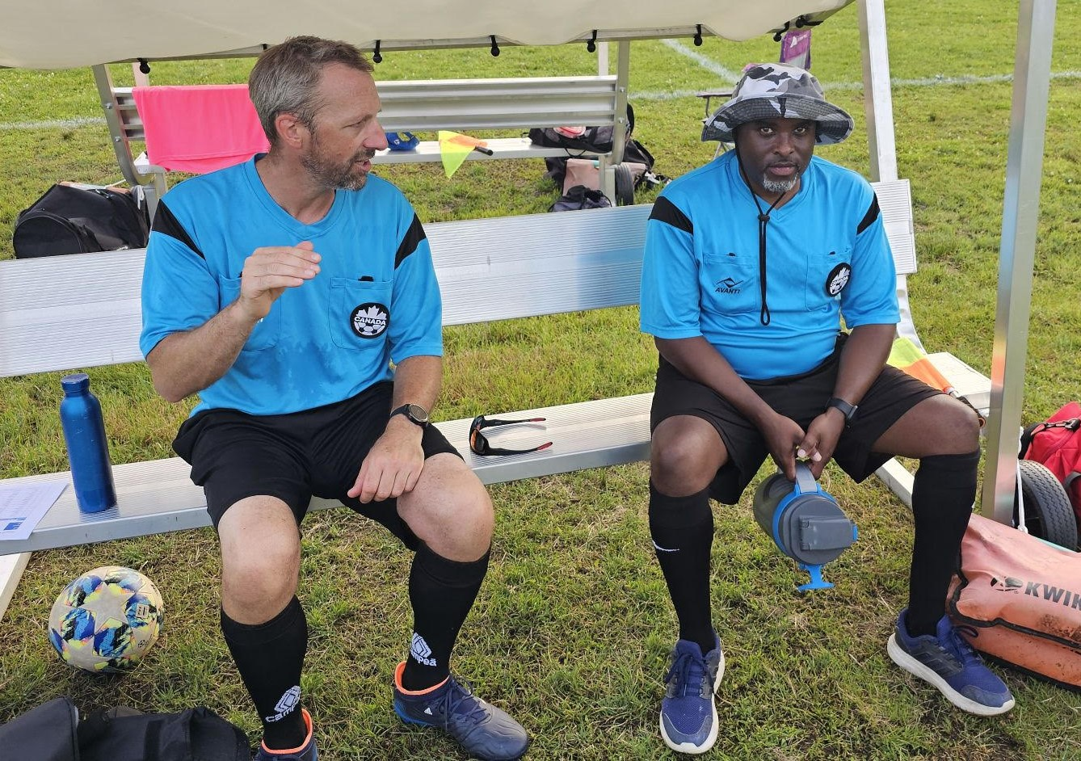
9. Head Referee Report (cont’d)
We were extremely successful in filling our match official assignments for 2024
(Ref and A/R’s, a rate of 98.7%)
Huntsville SC is always interested in bringing along new referees through our in-house mentor program, please contact us through our website to register for 2025.
in game analysis
Jez Bell & Marlon Jordan
New Match Official
Steve Abouldahab

Slide 25
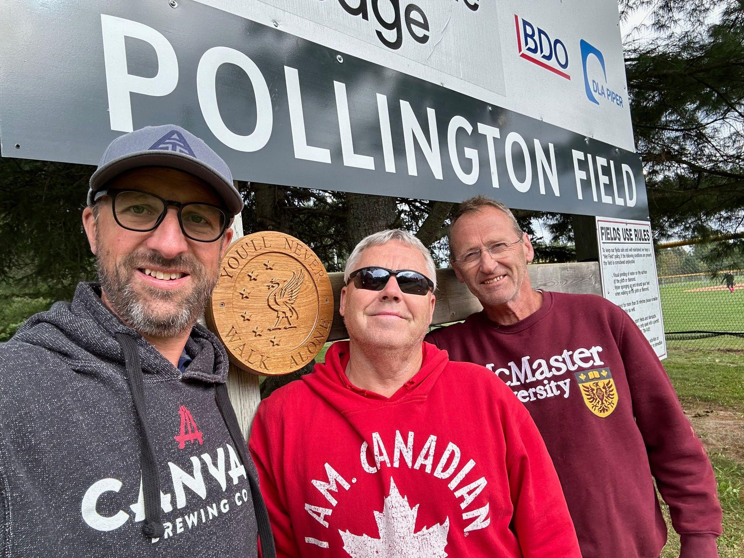
9. Head Referee Report (cont’d)
Pollington Field
In August 2024, the new sign was installed at the McCulley Robertson North Fields in memory and to honour our late friend and former match official, Graham Pollington.
The official celebration and grand opening of Pollington Field will be held at a later date (likely in late Spring/early Summer of 2025), so we can enjoy a game of football in his honour afterwards.
RIP Graham, YNWA…….
Fellow Referees Jez, Glen & Mike pay tribute to our friend, Graham Pollington

Slide 26
10. Treasurer Report
The Club is reporting a net income of $17,434 compared to $12,700 in the 2023 fiscal year.
Revenue:
Interest contributed to $5,853 of total income which came from the RBC GIC and Tangerine Savings account.
Donations totalling $2,444 were made to the Club through the new donations feature in Sports Engine when players are registering and by referee fee donations.
Sponsorship income increased slightly from the prior year.
Registration income decreased slightly due to MUFC taking over more programming.
Expenses for the Club continue to be kept relevant and sustainable. The largest typical costs are wages, referee fees, uniforms, field rental and membership fees for HDSA and OSA.
League summary:
House League
Fall program - this continued another revenue stream from Youth with great success.
Summer program - registrations for youth and women’s were higher than 2023, co-ed is similar to prior year
Indoor - revenue was similar to prior year
Donations made by the Club:
Kicks for Kids through Kelly Burmeister - $783 from Carlos Burmeister Memorial Tournament
Town of Huntsville - $25,654 for new covered benches

Slide 27
10. Treasurer Report (cont’d)
A new Savings account has been opened with RBC to make better use of the funds sitting in the Chequing account.
The 1 year non-redeemable RBC GIC for $100k has been renewed and will earn 3.15%
We are in the process of closing the Tangerine savings account and moving the balance over to RBC to simplify administration.
The RBC bank account type is being changed from a Community account to a Digital Choice account which will save an average of $19.30 in fees every month.
A second board member is being given access to the RBC bank account so that bills can continue to be paid in the event that the treasurer is unable to do so.
Kelly Burmeister has generously offered for the donations collected at the Carlos Burmeister Memorial Tournament to be split equally between the Club and Kicks for Kids going forward.
The Club continues to remain in a strong financial position with Net Assets at $262K.

Slide 28
10. Financial Audit; Auditor
HSC has received our financial audit from BDO for the last fiscal year. Copies of the financials are
available on request.
The statement summary from BDO is as follows:
We have audited the financial statements of Huntsville Soccer Club (the Club), which comprise the statement of financial position as at August 31, 2024, the statements of operations and net assets and cash flows for the year then ended, and notes to the financial statements, including a summary of significant account policies.
In our opinion, the accompanying financial statements present fairly, in all material respects, the financial position of the Club as at August 31, 2024, and its results of operations and its cash flows for the year then ended in accordance with Canadian accounting standards for not-for-profit organizations.
APPOINTMENT OF AUDITOR: MOTION

Slide 29
11. 2024 Club Sponsors

Slide 30
11. 2024 Adult and WL Sponsors

Slide 31
11. 2024 Adult Sponsors

Slide 32
12. Tonight’s Elections
The following positions are up for election:
*Nominations can be made from the floor for position where there is no one nominated
POSITION | NOMINATED
President | Steph Nasturzio **
Head Referee | Glen Duffield **
Secretary | Marlon Jordan **
Women’s Director | Mike Hill **
At-Large | Haydn Kirby **
**Acclaimed

Slide 33
12. Support Positions
To assist the Executive, the following positions have been created–please spread the word about these vacancies:
POSITION | VOLUNTEER
Equipment Manager | Haydn Kirby
Assistant Treasurer | Vacant
Sponsorship Manager | Dan Gibbons
Assistant Minor Soccer | Vacant
Assistant Adult Coordinator | George Johns

Slide 34
13. 2025 Club Sponsors

Slide 35
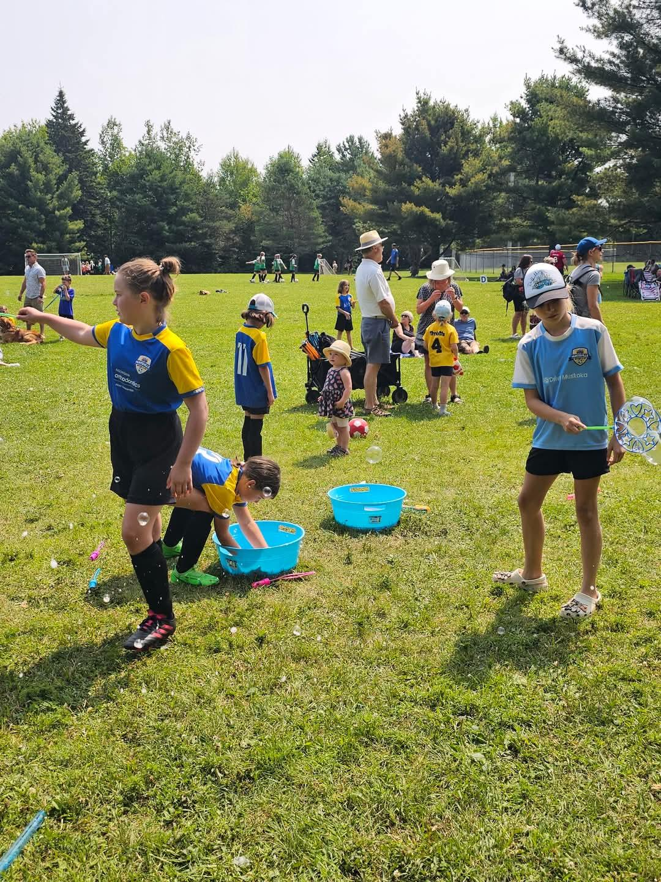
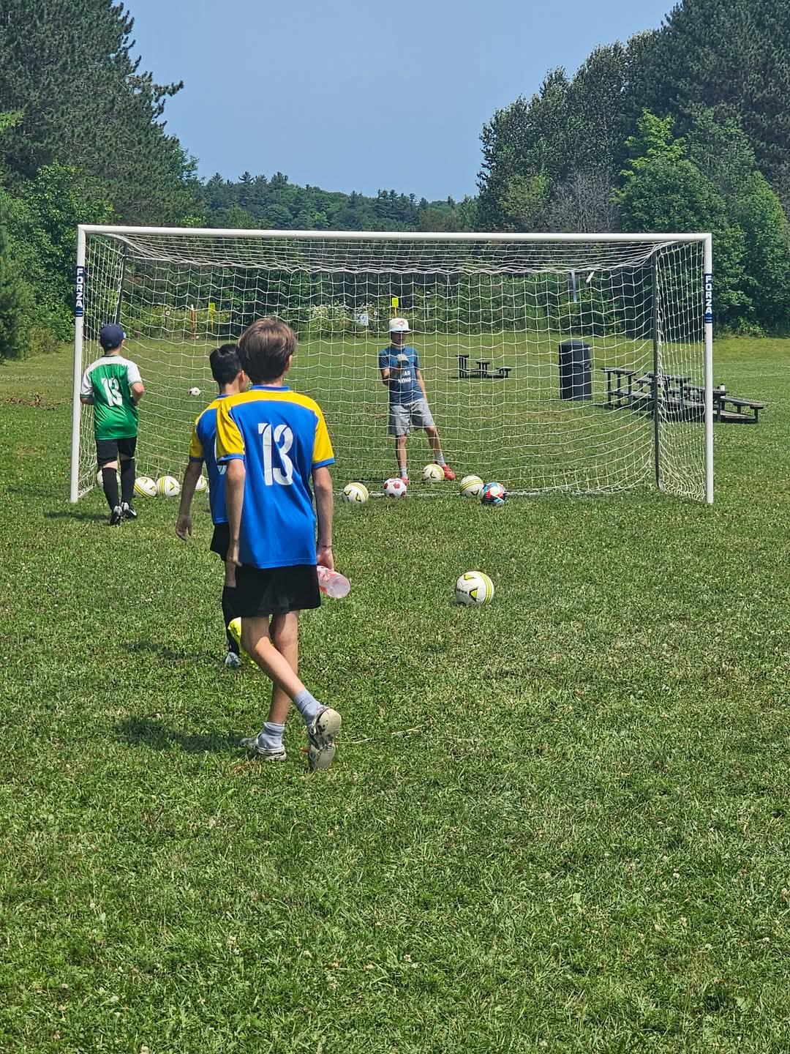
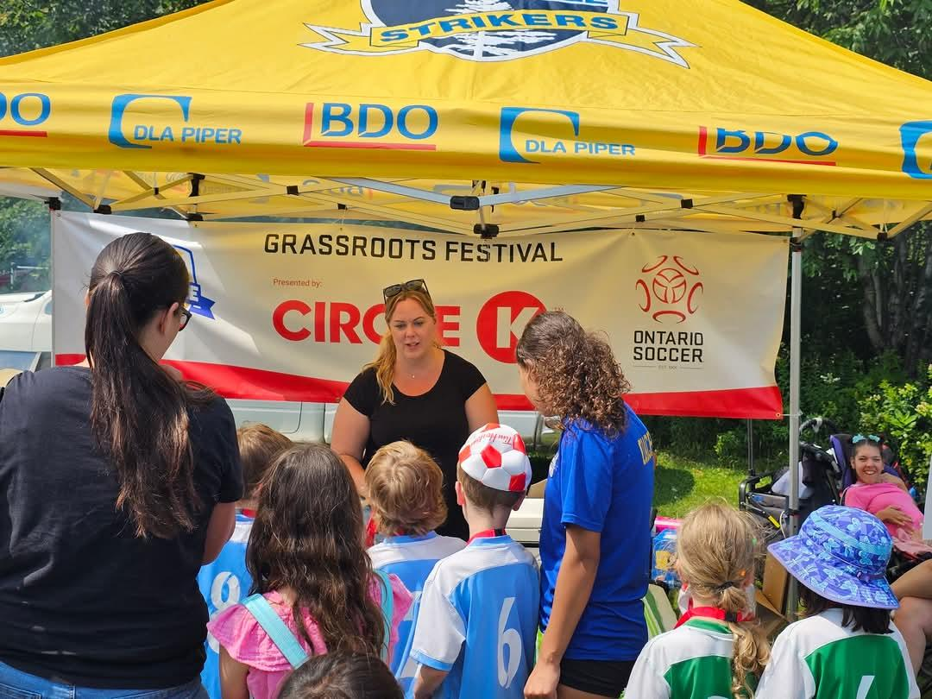
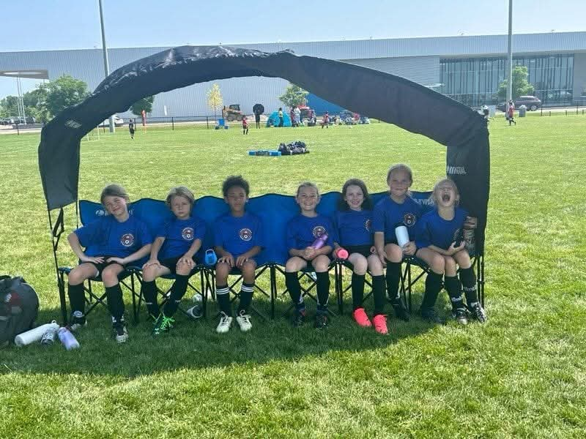
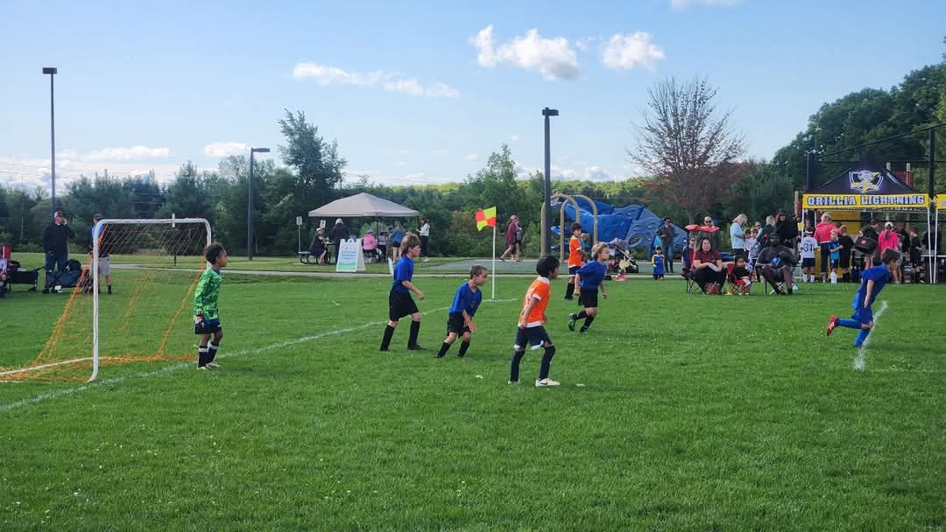
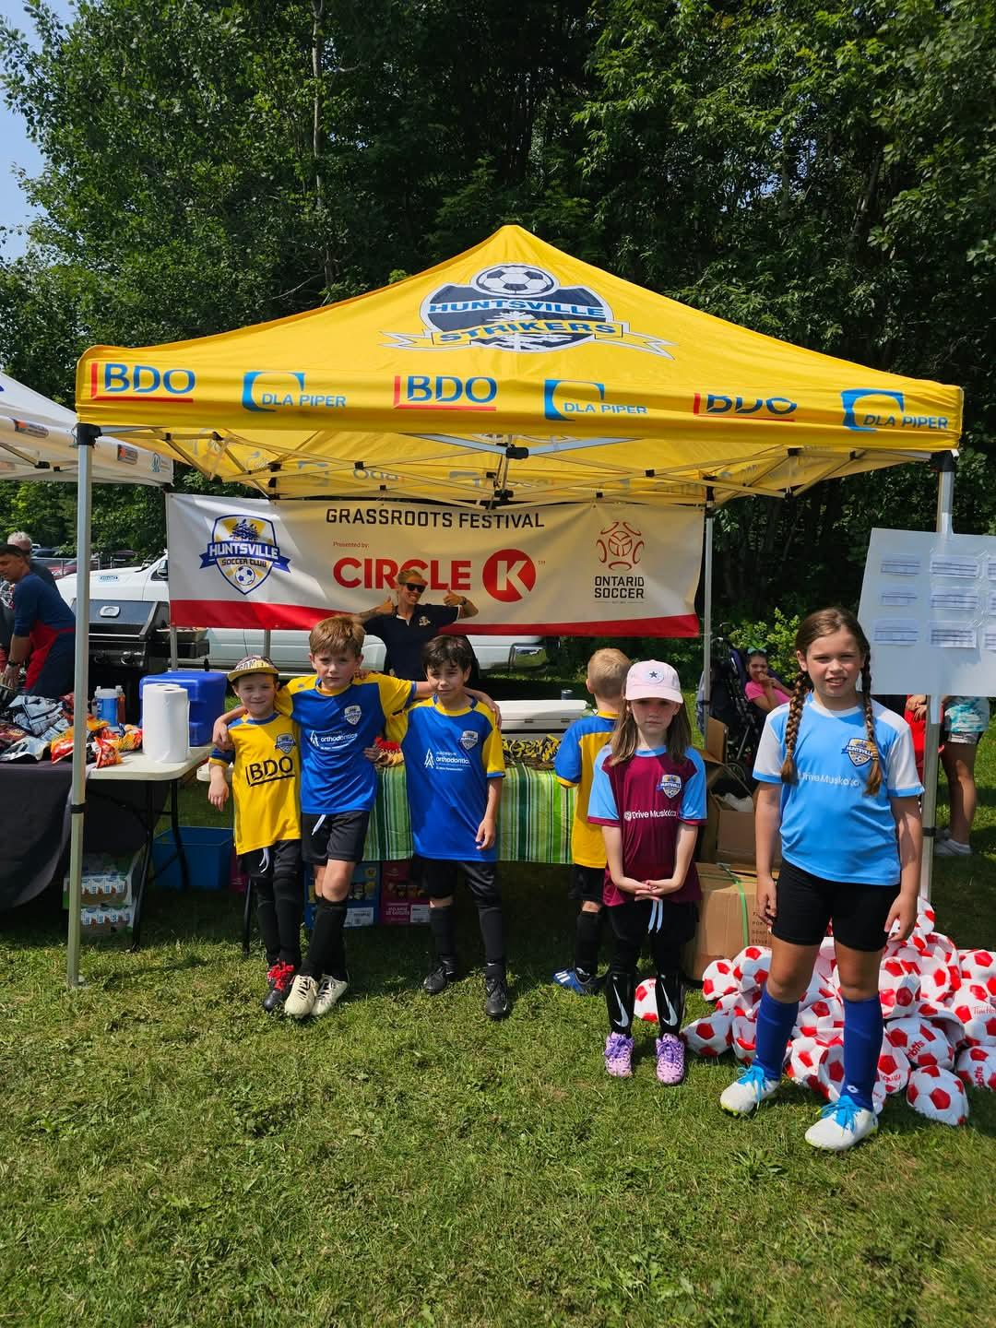
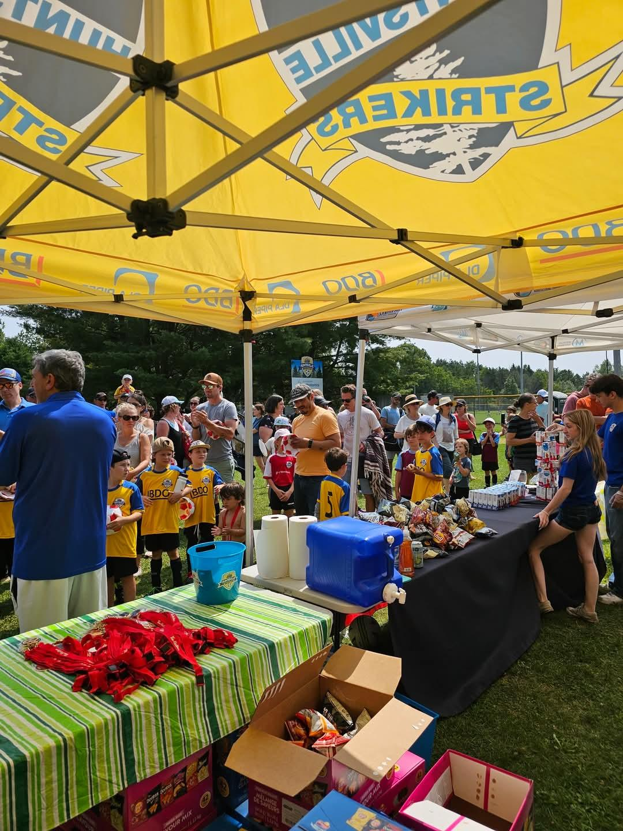
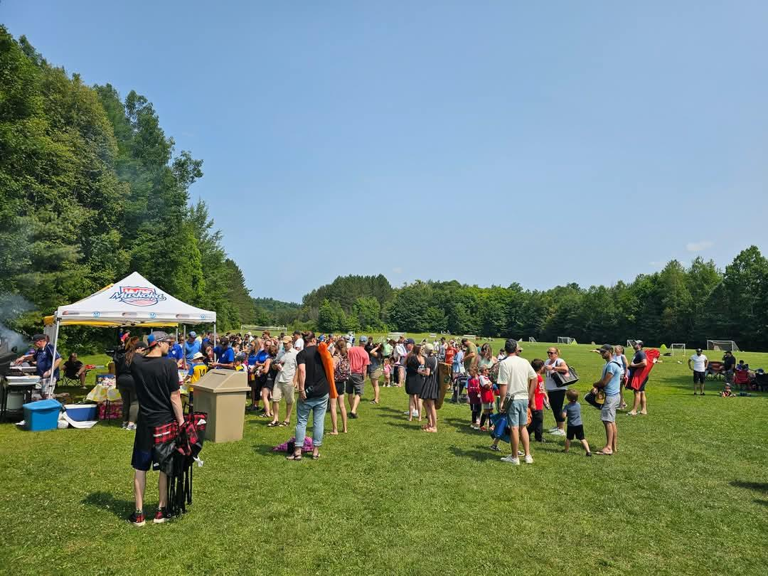
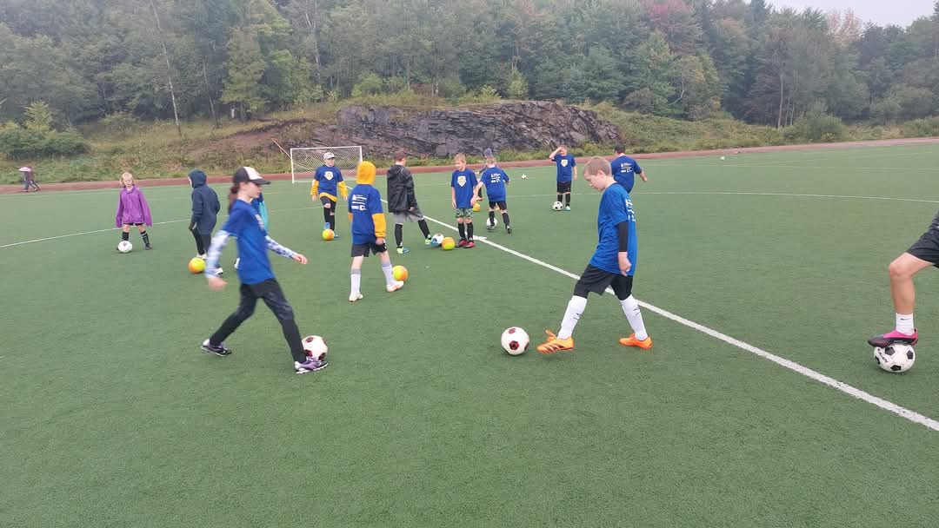
14. Q&A

